Slide 1

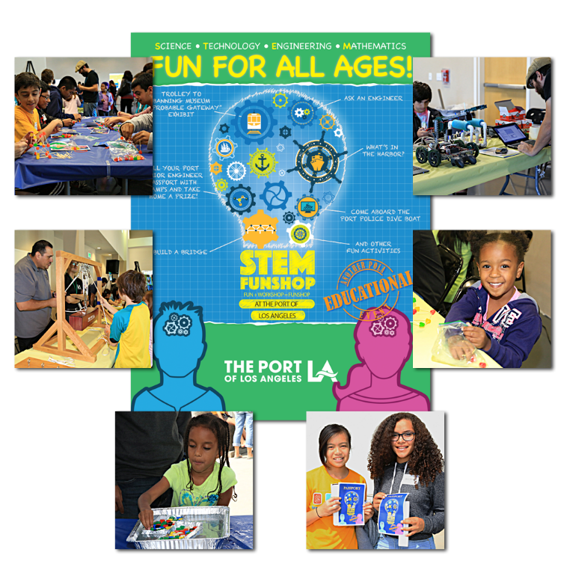
Port of
Los Angeles
STEM Funshop
Special Event

